Slide 1

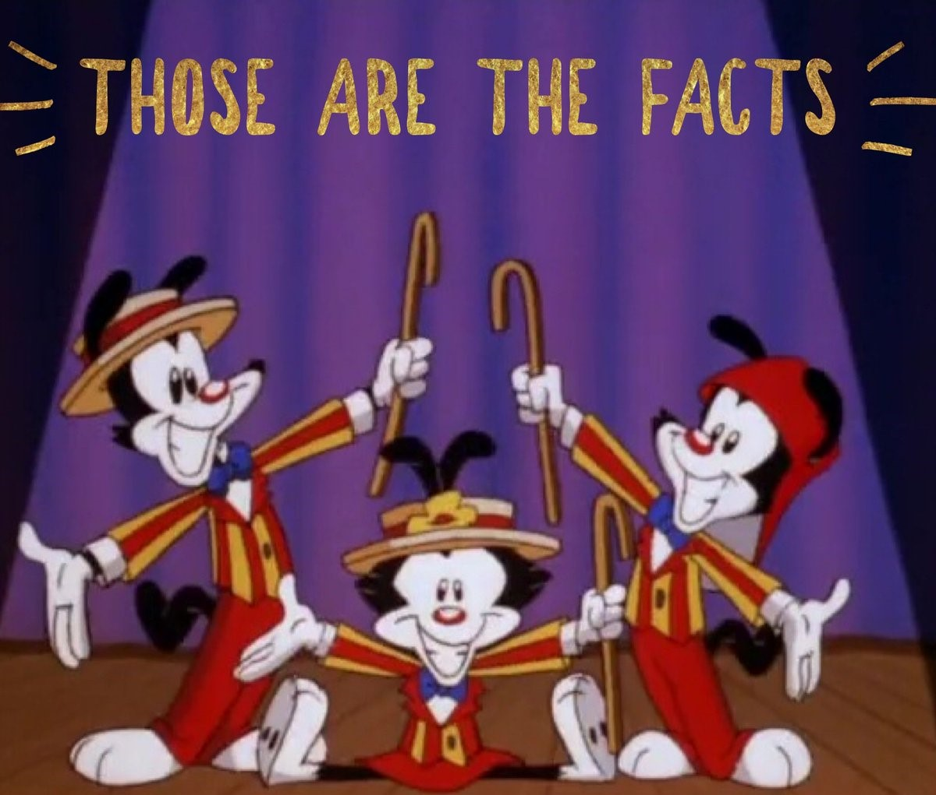
Crime Trends in the Atlanta Area
The DATAMANIACS:
Kelly Cash, Joe Kim, Betsy James, Grace Sun, Sophie Qiao

Slide 2
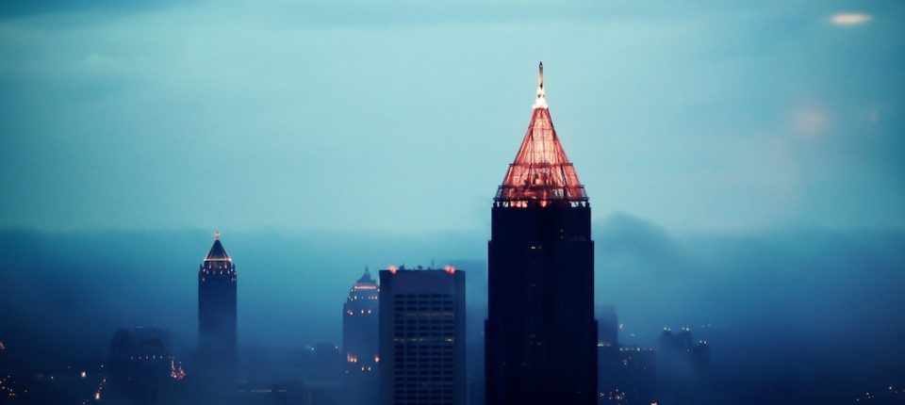

Overview
What general trends exist regarding crime in the Atlanta area?
Across years
Types of crimes committed
Seasons of the year
Months of the year
Time of day
Neighborhoods
Did general trends change in 2020 during the pandemic?

Slide 3

Data Cleanup & Exploration
Data obtained from Atlanta Police Department (https://www.atlantapd.org/) Raw Crime Data Download (2009-2020)
Challenges
Three csv files across years
Unmatching columns/headings
Formatting: dates, times
Bad data

Slide 4
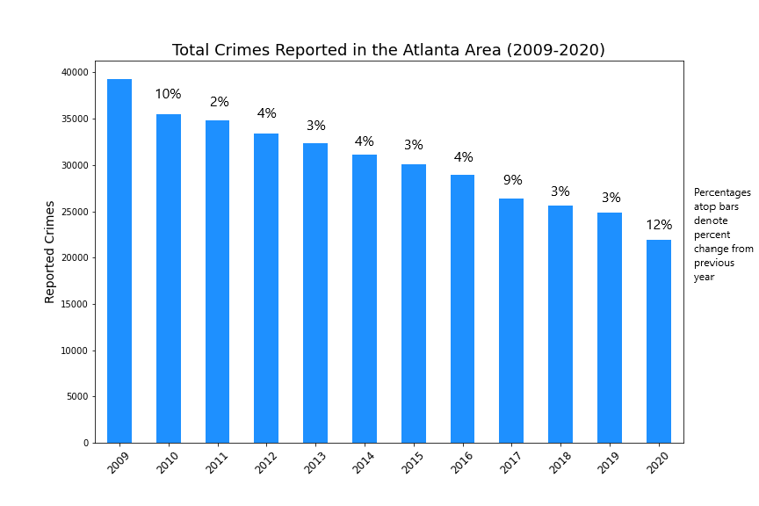

Overall crime trend 2009-2020: Decrease
Largest drop: 2020
Small, steady drops 2018, 2019
Focus on 2018-2019 for pandemic year comparison

Slide 5
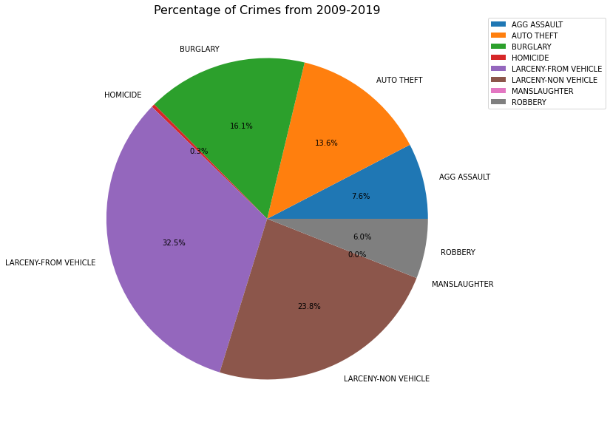
Crime Types

Slide 6
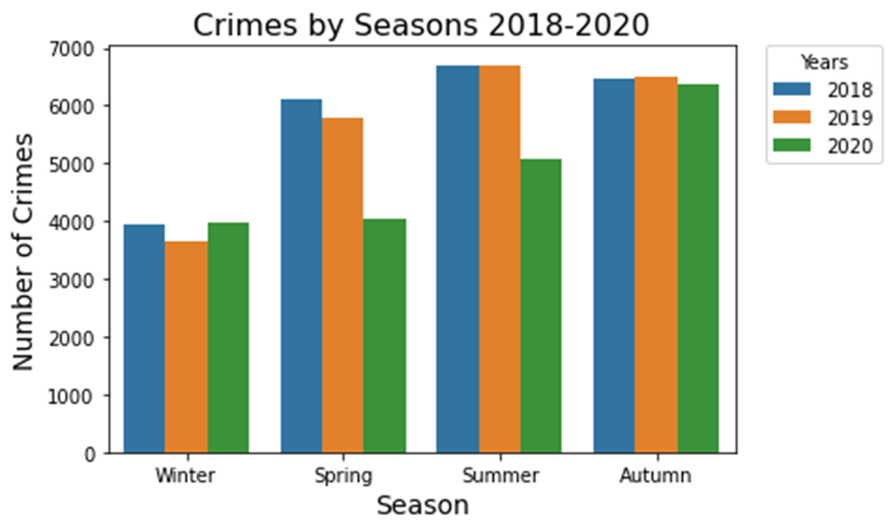
Which season has the lowest number of crimes?

Slide 7
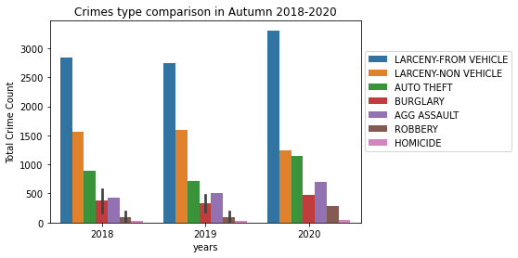
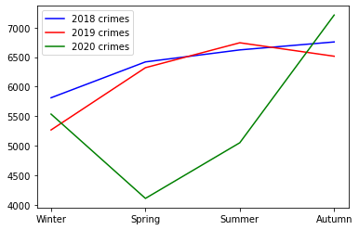
Which season has the highest number of crimes?

Slide 8
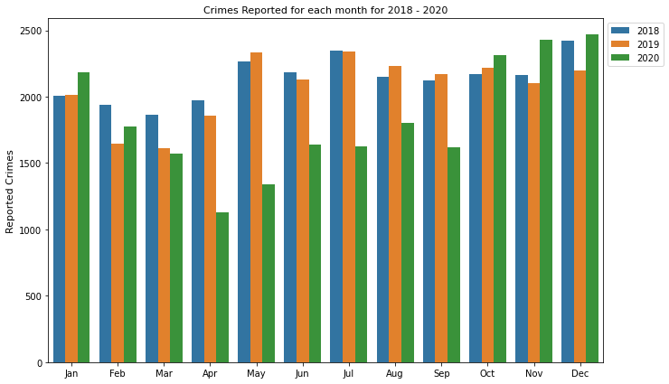
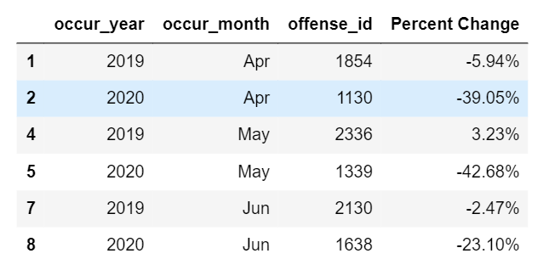
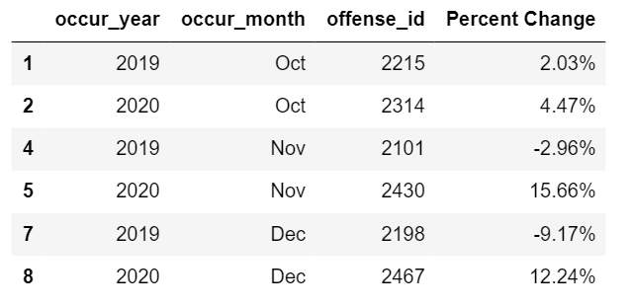
2020 Pandemic Effects on Crime

Slide 9
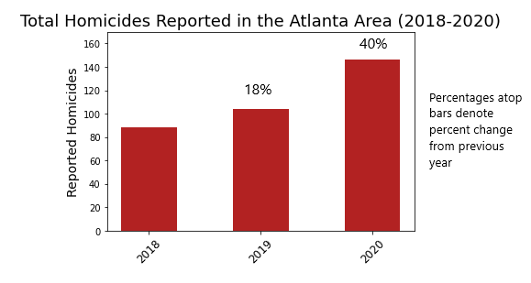
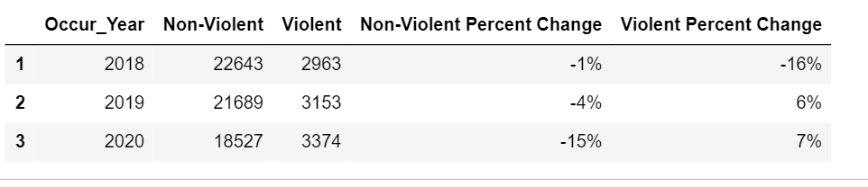
Violent vs Non-Violent

Slide 10
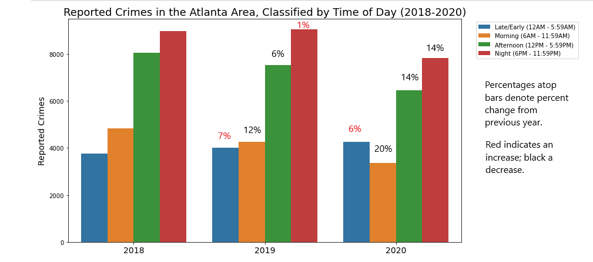
Crime trends by time of day
Most crimes occurring in the afternoon & night segments
2020
Decrease in morning, afternoon, night
Increase in late night/early morning

Slide 11
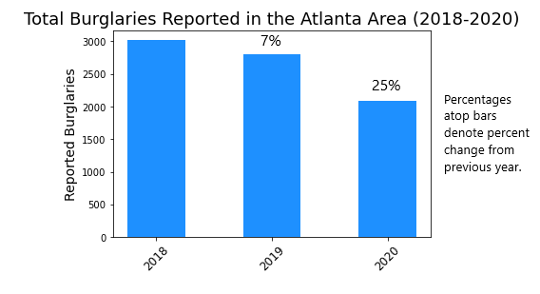
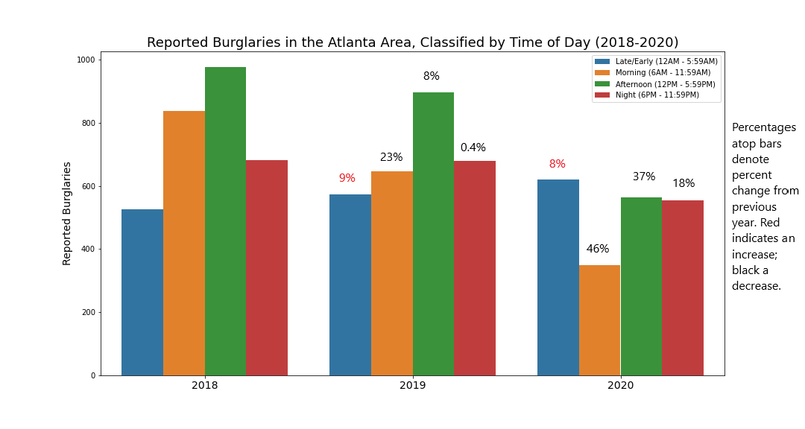
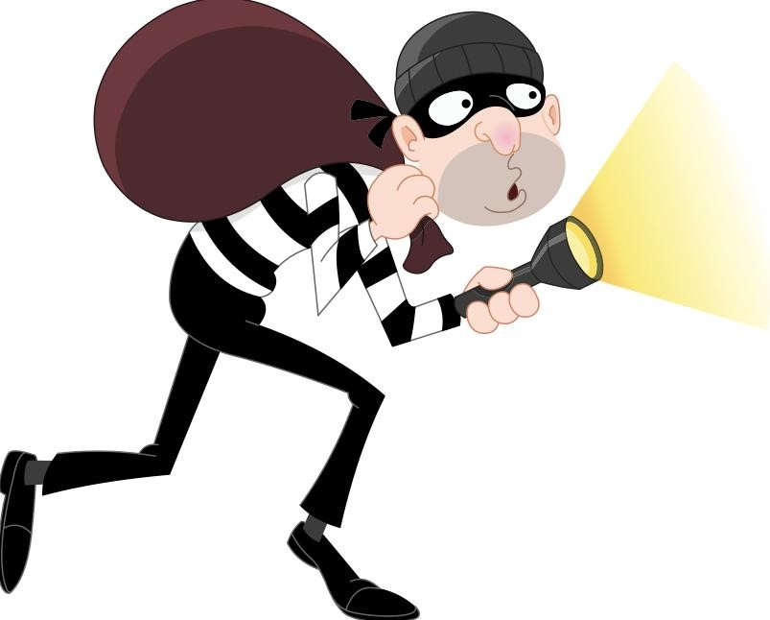
Burglary trends
Decrease in 2020
Much less in morning, afternoon, even night
Increase late night/early morning

Slide 12
Neighborhoods, 2018-2020
2018: 234 neighborhoods

Slide 13
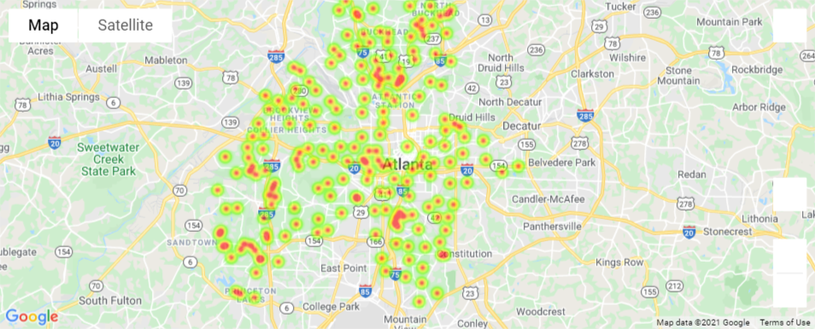
Neighborhoods with High Criminal Activity: 2020

Slide 14
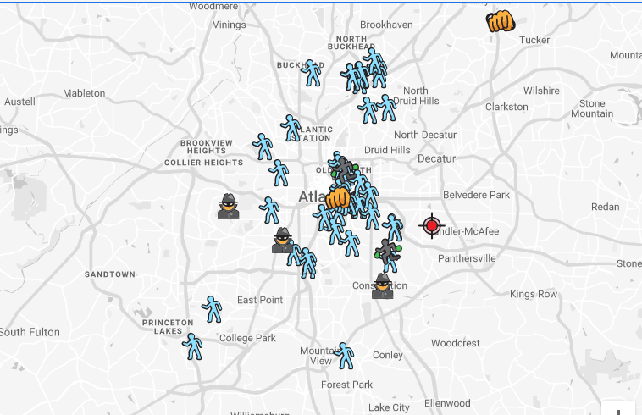
Crime Map for Atlanta from: spotcrime.com

Slide 15
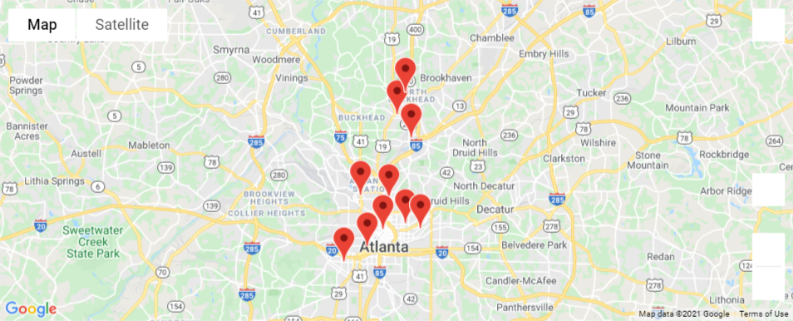
Top 10 Crime Spots : 2020

Slide 16
Discussion/Conclusions
Overall trends
Downward trend in crime from 2009
Less crime in winter
More crimes in afternoon & night
2020 trends
Decrease in Spring/Summer
Decrease in April/May by 40%
Decrease in non-violent (15%); increase in violent (7%) compared to 2018 & 2019
Decrease in burglary (25%), especially when people would normally be at work

Slide 17
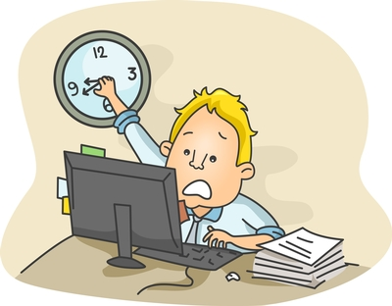





If we had more time…
Why has the crime dropped steadily since 2009?
Population changes?
Changes in police leadership? Policies?
Why did violent crime increase in 2020?
Mental health?
Unemployment?
Social justice issues?

Slide 18

Questions

Slide 19
